Slide 1
Predicting Synthetic Lethal Interactions using Machine Learning Algorithms
Ruiqi (Jacqueline) Jia
Supervisor: Pingzhao Hu

Slide 2





Outline
Background Information
Research Objectives
Methodology
Results
Conclusion

Slide 3

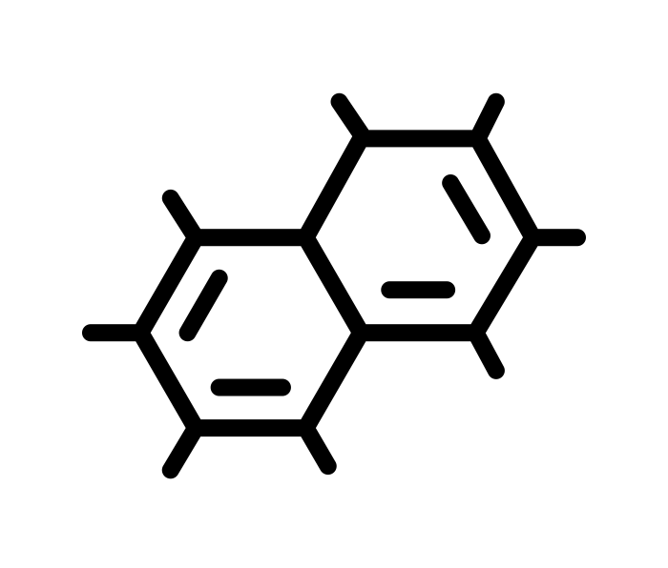





Synthetic Lethality (SL)
SL Pair
Advantages
Gene A
Gene B
Cell
Discovery targets for anti-cancer drugs
Selectively kill cancer cells without harming the normal cell
Wild-Type
Wild-Type
Viable
Mutant
Wild-Type
Viable
Wild-Type
Mutant
Viable
Known SL Pairs
PARP1 - BRCA1
PARP1 - BRCA2
Mutant
Mutant
Lethal
Gene altered in Cancer
Drug Target
Notes:
Synthetic Lethality (SL) plays an increasingly critical role in the targeted anticancer therapeutics. In addition, identifying SL interactions can create opportunities to selectively kill cancer cells without harming normal cells.
The PARP1 gene was found to be SL with both BRCA1 and BRCA2 genes in breast cancer. PARP1 inhibitors were later approved for use to selectively kill breast cancer cells with mutations in either of the BRCA1 or BRCA2 genes.

Slide 4


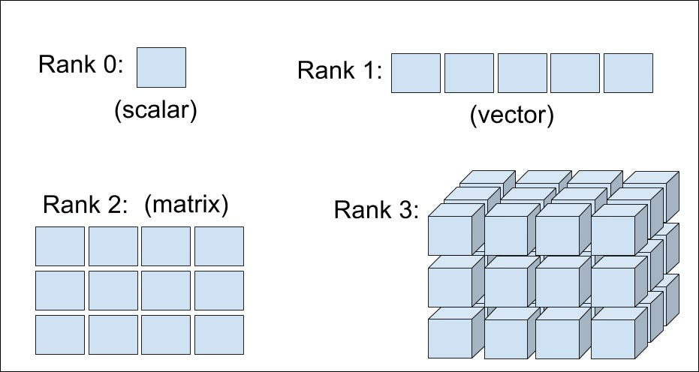
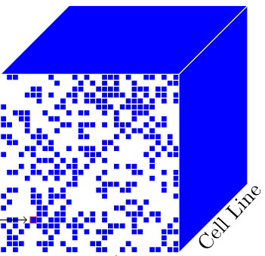
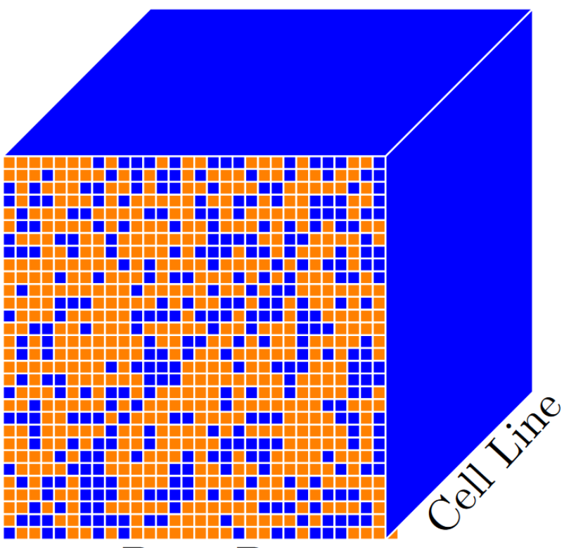
Tensor & Tensor Completion (TC)
Tensor
Common TC Algorithms
Scalar
CANDECOMP/PARAFAC-Weighted Optimization (CP-WOPT)
Convolutional Sparse Tensor Completion (CoSTCo)
Array
Matrix
Tensor
Completion
Higher Order Tensor
Gene
Gene
Cancer
Type
Cancer
Type
Gene
Gene
This project focus only on order 3 tensor
J. S. Zammit. End-to-End Trainable Deep Tensor Completion Algorithms with Multimodal Data Fusion for Anticancer Drug Synergy Prediction, 2023.

Slide 5
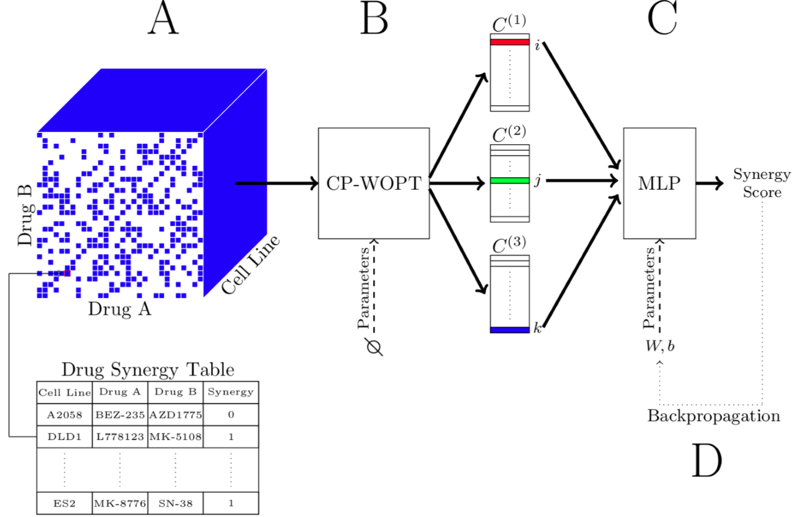





Deep Tensor Factorization (DTF)
Advantages
Handling High-Dimensional Data
Improved Predictive Accuracy
Reduction of Dimensionality
Interaction Score
Genes
Disadvantages
Cancer type
Lack of End-to-End Trainability
Parameter Selection Sensitivity
Curse of Dimensionality
Genes
Gene SL Interaction Table
Gene | Gene | Cancer Type | SL inter.
BLM | TTC31 | COAD | 0
BMPR1A | MYC | SKCM | 1
. . . .
ATR | RELA | LAML | 1
Tensor decomposition
Q: How can we improve the DTF to end-to-end based?
Deep Neural Network(DNN)
DSCP
Notes:
(A) Drug-drug synergy (DDS) data was collected to construct a tensor. The synergy values were binarized to create synergy status, serving as labels to train the MLP. (B) The tensor is decomposed into a set of three factor matrices, ℂ, using CP-WOPT. (C) To predict the synergy score of the (𝑖,𝑗,𝑘)𝑡ℎ component of the DDS tensor, we input the 𝑖𝑡ℎ, 𝑗𝑡ℎ and 𝑘𝑡ℎ rows of the respective factor matrices into the MLP. (D) We update the weights and biases of the MLP using standard backpropagation. Note that CP-WOPT and the MLP are not trained in an end-to-end fashion.

Slide 6



Research Objectives
Evaluate DSCP algorithm to predict SL interaction
Benchmark its performance with two-stages models (DTF and Deep Synergy)
Notes:
Apply DSCP algorithm to predict SL interaction
Benchmark its performance with two-stages models (DTF and Deep Synergy)

Slide 7
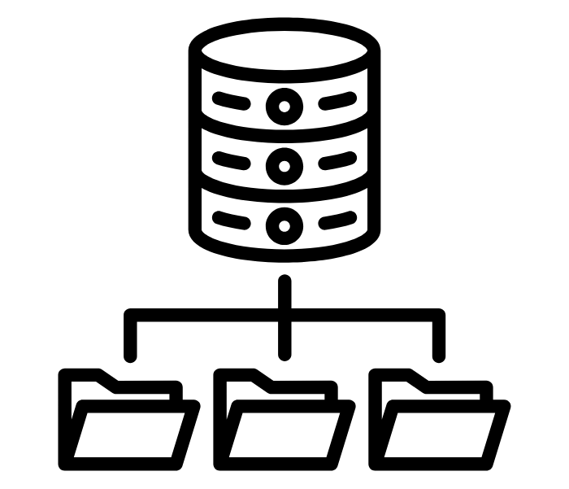


Data Overview
Variables
Gene SL Interaction Data
Gene1 | Gene2 | Cancer Types | SL inter.
BLM | TTC31 | COAD | 0
BMPR1A | MYC | SKCM | 1
…
ATR | RELA | LAML | 1
Gene 1
Gene 2
Cancer Types
SL Interaction
Binary Outcome
Classification
Problem

Slide 8



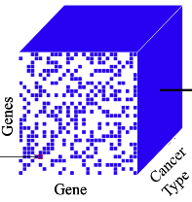

Data Preprocessing and Integration
Data Cleaning
Construct Tensor
Removing irrelevant Data
Mapping into Cancer genes
Leave-One-Drug-Out
Cross Validation
Final Tensor shape:
2075 x 2075 x 8
Total Observations:
67748

Slide 9
Research Objectives
Evaluate DSCP algorithm to predict SL interaction
Benchmark its performance with two-stages models (DTF and Deep Synergy)
Notes:
Apply DSCP algorithm to predict SL interaction
Benchmark its performance with two-stages models (DTF and Deep Synergy)

Slide 10

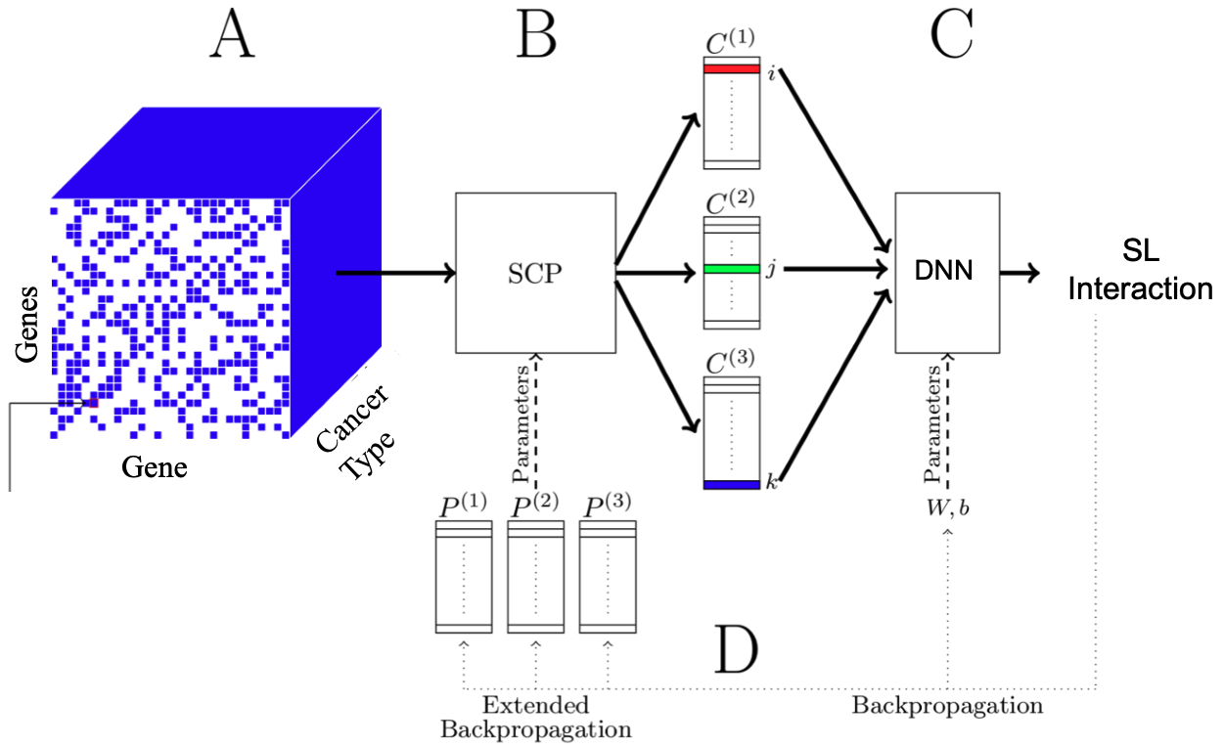



Deep Selective CANDECOMP/PARAFAC (DSCP)
The Workflow of DSCP Algorithm
A: Data preprocessing and tensor construction
B: Tensor decomposed into three metrics (C(i)s) using SCP
C: Predict the SL interaction using Deep Neural Network
GGC Tensor
D: Update weights and bias of the DNN

Slide 11
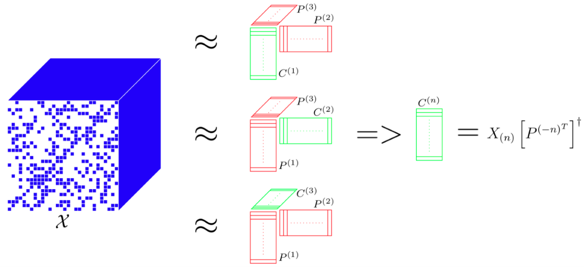
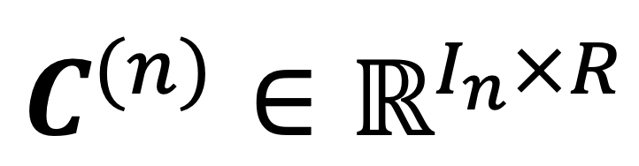
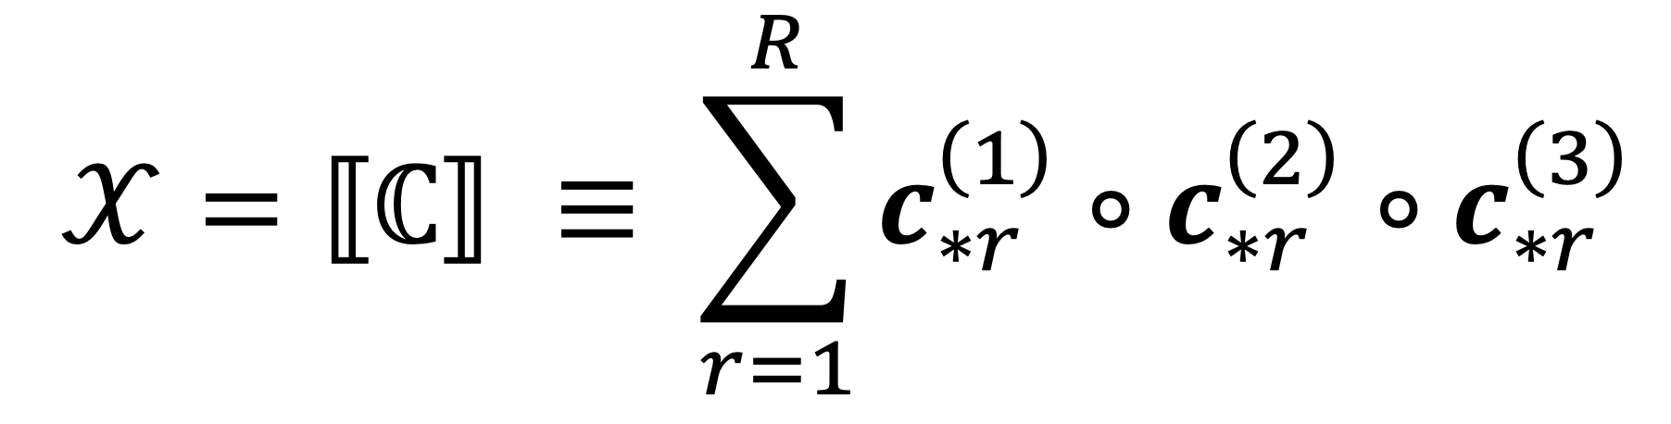
Selective CANDECOMP/PARAFAC (SCP)
Why SCP?
Selectively compress information that is directly relevant for classification
GGC Tensor
Parameter Matrices
Second sets of matrices P = {P1, P2, P3}
Same size as factor metrics
Contain relevant info
Gene
Gene
Cancer
Type
Notes:
𝒳 is a tensor belonging to R𝐼1×𝐼2×𝐼3. P = {𝑷(1),𝑷(2),𝑷(3)} are matrices belonging R𝐼𝑛×𝑅, where R is a hyperparameter. P acts as parameters to SCP. Conceptually, they contain the features that are relevant for classification. C is the output of SCP and is the same size as P. Conceptually, they indicate the prevalence of the features contained in P. SCP aims to find the values for C that best reconstructs 𝒳. This has the simple closed–form solution shown in the right-most equation. Red matrices indicate that the matrix is fixed parameter, green matrices indicate that the matrix is a free variable.

Slide 12
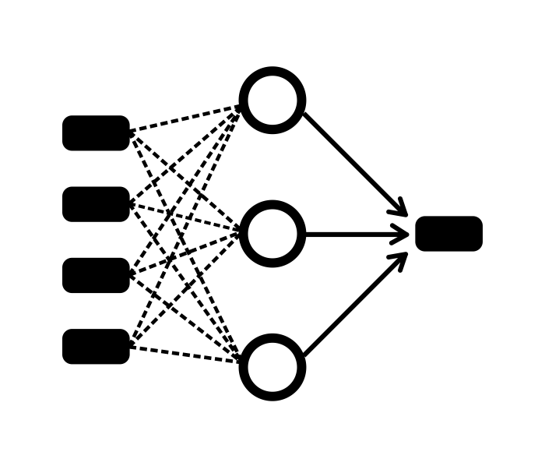
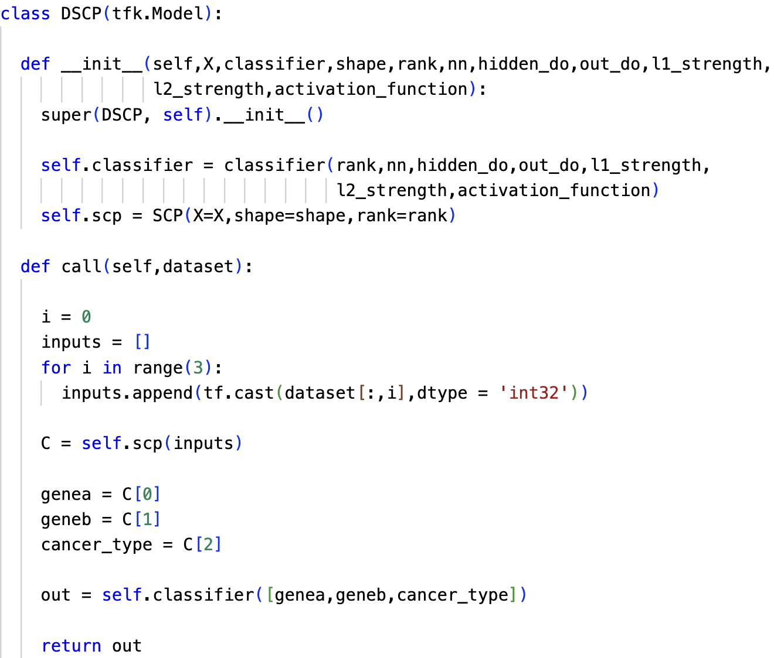



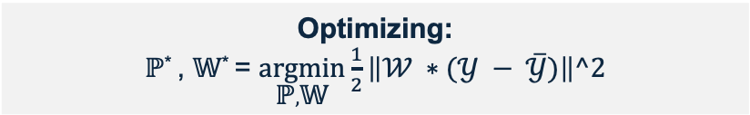
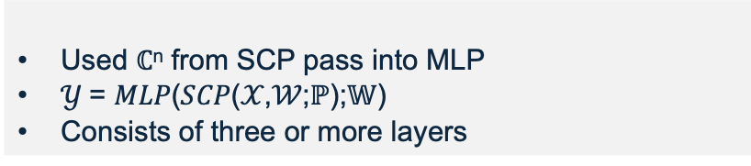
End-to-End Application
Attach DNN to SCP
Deep Neural Network
Used ℂ^{n} from SCP pass into MLP
$𝒴$= 𝑀𝐿𝑃(𝑆𝐶𝑃(𝒳,𝒲;ℙ);𝕎)
Consists of three or more layers
Optimizing:
ℙ* , 𝕎* = $\underset{\text{ℙ},\text{𝕎}}{argmin}{\frac{1}{2}\left\|\text{𝒲} ∗(𝒴 − \overline{𝒴})\right\|^2}$
Notes:
Change the title
Add the train

Slide 13
Research Objectives
Apply DSCP algorithm to predict SL interaction
Benchmark its performance with two-stages models (DTF and Deep Synergy)
Notes:
Apply DSCP algorithm to predict SL interaction
Benchmark its performance with two-stages models (DTF and Deep Synergy)

Slide 14

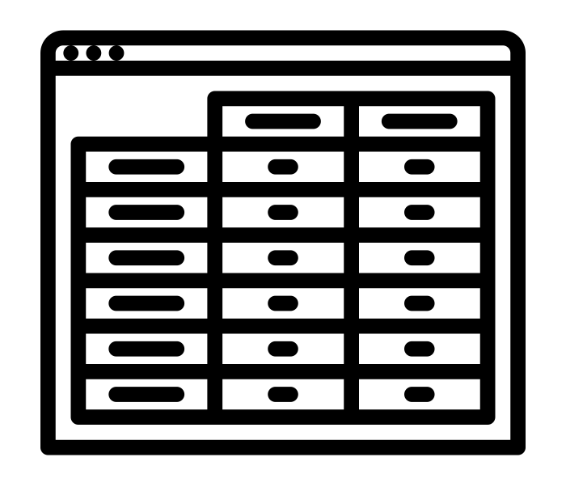


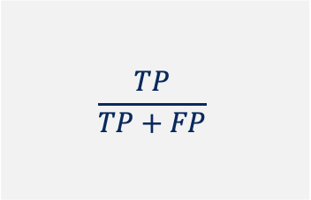
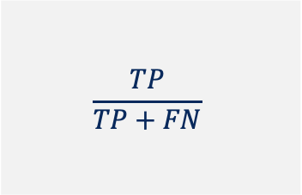
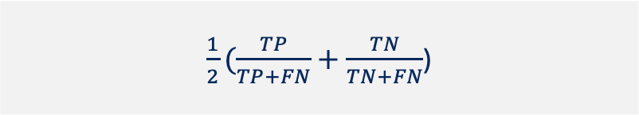
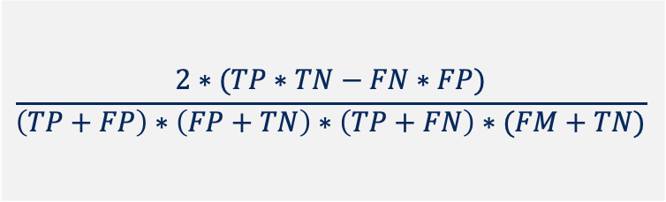
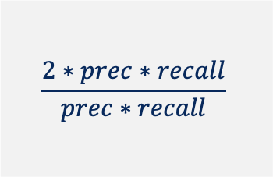
Evaluation Metrics
 | Predicted Positive | Predictive Negative
Actual Positive | True Positive (TP) | False Negative (FN)
Actual Negative | False Positive (FP) | True Negative (TN)
Kappa
$$\frac{2∗(TP∗TN−FN∗FP)}{\left(TP+FP\right)∗\left(FP+TN\right)∗\left(TP+FN\right)∗(FM+TN)}$$
ROC-AUC
PR-AUC
F1 score
Recall
Precision
The TP rate and FP rate of an algorithm over a range of thresholds
The precision and recall of an algorithm over a range of thresholds
$$\frac{2∗prec∗recall}{prec∗recall}$$
$$\frac{TP}{TP+FN}$$
$$\frac{TP}{TP+FP}$$
Balance Accuracy
$\frac{1}{2}(\frac{TP}{TP+FN}+\frac{TN}{TN+FN}$)

Slide 15

Results
Algorithms | ROC-AUC | PR-AUC | Recall | Precision | F1 Score | BACC | KAPPA
DSCP | 0.73 ± 0.00 | 0.56 ±0.01 | 0.78 ±0.03 | 0.30 ±0.02 | 0.43 ±0.01 | 0.73 ±0.00 | 0.28 ±0.02
DTF | 0.74 ±0.02 | 0.56 ±0.02 | 0.73 ±0.04 | 0.35 ±0.02 | 0.37 ±0.02 | 0.74 ±0.02 | 0.33 ±0.03
Deep Synergy | 0.69 ±0.01 | 0.55 ±0.01 | 0.77 ±0.06 | 0.25 ±0.03 | 0.39 ±0.02 | 0.69 ±0.01 | 0.20 ±0.03
Notes:
Use animation when presented the eva

Slide 16






Conclusion
Summary
Limitations
Future Study
Evaluated the DSCP algorithms on Binary Classification Problem
Complex models are sensitive to gene selection bias
Further extend the modeling capability of these methods, improve the hyperparameters, and evaluate the methods on other datasets
DSCP has a better performance than the Deep Synergy but not DTF
Class Imbalance
(over sampling)
Lack of Generalizability

Slide 17
References
Liu, C., Hogan, A.M., Sturm, H. et al. Deep learning-driven prediction of drug mechanism of action from large-scale chemical-genetic interaction profiles. J Cheminform 14, 12 (2022). https://doi.org/10.1186/s13321-022-00596-6
Sun, Z., Huang, S., Jiang, P., & Hu, P. (2020). DTF: Deep Tensor Factorization for predicting anticancer drug synergy. Bioinformatics, 36(16), 4483–4489. https://doi.org/10.1093/bioinformatics/btaa287
T. G. Kolda, B. W. Bader. Tensor Decompositions and Applications. SIAM Review, Vol. 51, No. 3, pp. 455-500, 2009. https://doi.org/10.1137/07070111X
J. S. Zammit. End-to-End Trainable Deep Tensor Completion Algorithms with Multimodal Data Fusion for Anticancer Drug Synergy Prediction, 2023.
Liany, H., Jeyasekharan, A., & Rajan, V. (2019). Predicting Synthetic Lethal Interactions Using Heterogeneous Data Sources. https://doi.org/10.1101/660092
Feng, Y., Long, Y., Wang, H., Ouyang, Y., Li, Q., Wu, M., & Zheng, J. (2023). Benchmarking Machine Learning Methods for Synthetic Lethality Prediction in Cancer. https://doi.org/10.1101/2023.11.21.567162

Slide 18







Acknowledgement
Dr.Pingzhao Hu
HuLab
Professor Tony Panzarella
Ryan
Rosner

